Slide 1


Ritayan
2022/11/06

Slide 2

Outline
Executive Summary
Introduction
Methodology
Results
Conclusion
Appendix

Slide 3
Executive Summary
The objective of this project was to predict the success rate of SpaceX Falcon 9 first stage landing.
Methodologies
Data collection using API.
Data wrangling.
Exploratory Data Analysis using SQL.
Interactive Maps applying Folium.
Interactive Dashboard with Plotly.
Predictive Analysis through classification.
Findings
Exploratory data analysis results.
Data visualizations.
Best predictive model.

Slide 4
Introduction
Background
SpaceX is one of the most prestigious private companies in the world, that is involved in designing, manufacturing and launching rockets and satellites to space. SpaceX has contracts with NASA and the US DoD. One of the biggest achievements of SpaceX was to decrease the launch prices of rockets by more than 60%, pushing prices down in the entire industry. They were able to do that by reusing the first stage boosters, instead of expending them.
For this project, we have tried to predict if the Falcon 9’s first stage will land successfully for a given launch, helping us to get a more accurate idea of the cost of launch.
Objectives
We want to determine how successful is the first stage and the probabilities of landing. In order to conduct the analysis the following questions need to be addressed.
What factors influence in making a landing successful?
Which variables are the most influential for the success rate?
In order to have the best results and ensure a successful landing, what conditions are required?
What is the most optimal rocket to use for a successful landing?

Slide 5

Section 1

Slide 6
Methodology
The methodology used for this project is divided into five different stages ranging from compiling data, cleaning, to visualization and finally model prediction.
Data collection
SpaceX Rest API
Web Scrapping from Wikipedia
Data wrangling
One hot encoding data fields for Machine Learning and Dropping irrelevant columns.
Exploratory data analysis (EDA) using visualization and SQL
The use of diverse plots such as bar, scatter plots, to reveal the variable’s relationship and provide patterns inside the data.
Interactive visual analytics using Folium and Plotly Dash
Use Folium and Plotly to create maps and Dashboards.
Predictive analysis using classification models
Build, train and evaluate models including Logistic Regression, SVM, Decision Tree and KNN.

Slide 7
Data Collection
Dataset was collected using the Space X REST API which covers different information such as flight number, date, payload mass, and landing pad, among others. The main objective of using this dataset was to predict whether Space X will be able to successfully land the stage 1 boosters.
In order to start working with the dataset. We need to :
Get Data from the API or Website by scrapping.
Transform the data into a data frame.
Filter the data frame as required before starting to work with the valuable information .
Export the final dataset.

Slide 8
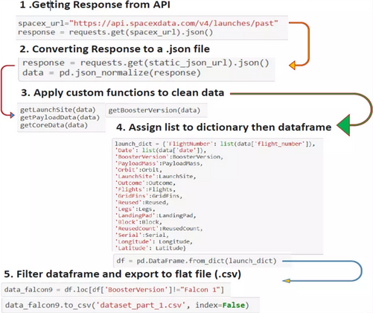
Data Collection – SpaceX API
The API used is https://api.spacexdata.com/v4/rockets/
The API provides data about many types of rocket launches done by SpaceX, the data is therefore filtered to include only Falcon 9 launches.
Every missing value in the data is replaced the mean the column that the missing value belongs to.
We end up with 90 rows or instances and 17 columns or features.

Slide 9
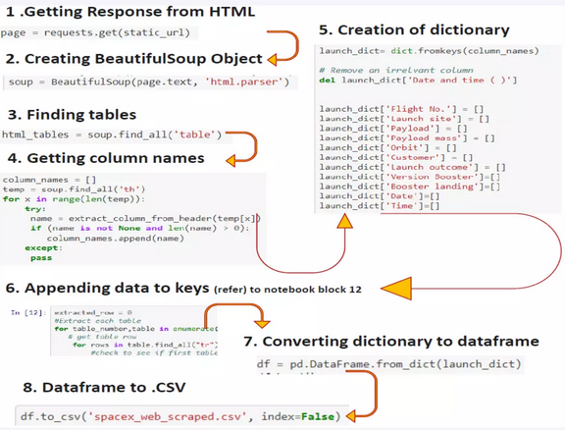
Data Collection - Scraping
The data is scraped from : https://en.wikipedia.org/w/index.php?title=List_of_Falcon_9_and_Falcon_Heavy_launches&oldid=1027686922
The website contains only the data about Falcon 9 launches.
We end up with 121 rows or instances and 11 columns or features.

Slide 10
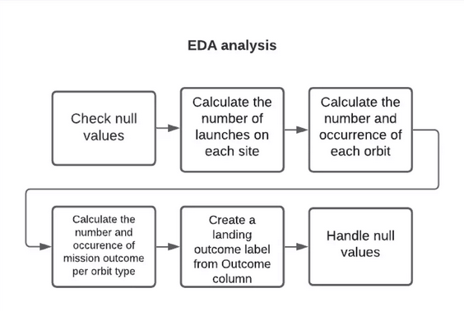
Data Wrangling
The data is later processed so that there are no missing entries and categorical features are encoded using one-hot encoding.
An extra column called ‘Class’ is also added to the data frame. The column ‘Class’ contains 0 if a given launch is failed and 1 if it is successful.
In the end, we end up with 90 rows or instances and 83 columns or features.

Slide 11
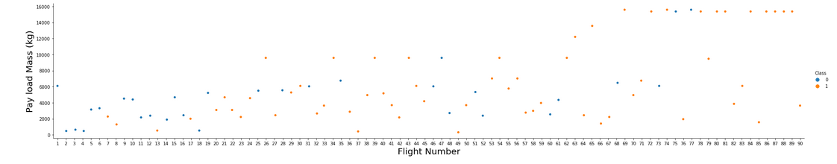
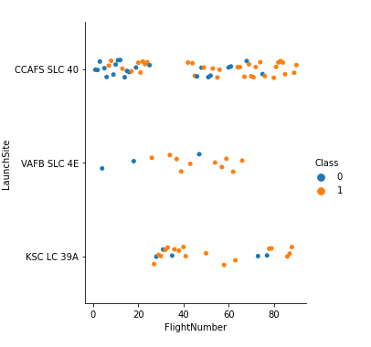
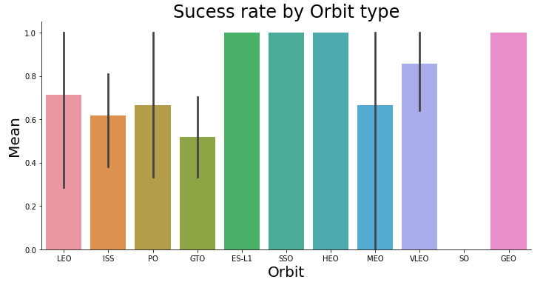
EDA with Data Visualization
We use EDA to summarize the main characteristics of our data set and to find different patterns amongst the data. In order to summarize these characteristics, it is necessary to use statistical tools such as graphs. A list of the graphs plotted :
Relationships between groups using Scatter plots:
Flight number and Payload Mass
Flight number and Launch Site
Payload and Launch Site
Orbit and Flight number
Payload and Orbit
Orbit and Payload Mass
Patterns between groups using Bar plots
Orbits and the mean
Success rates using Line plots
Success rate by year

Slide 12
EDA with SQL
Summary of the SQL queries executed on IBM’s DB2 database.
The names of the unique launch sites in the space mission.
5 records where launch sites begin with ‘CCA’.
The total payload mass carried by boosters launched by NASA (CRS).
The average payload mass carried by booster version F9 v1.1.
The date when the first successful landing outcome in ground pad was achieved.
The names of the boosters which have success in drone ship and have payload mass greater than 4000 but less than 6000.
The total number of successful and failure mission outcomes.
The names of the booster versions which have carried the maximum payload mass.
The failed landing outcomes in drone ship, their booster versions, and launch site names for in year 2015.
The count of landing outcomes between the date 2010-06-04 and 2017-03-20, in descending order.

Slide 13
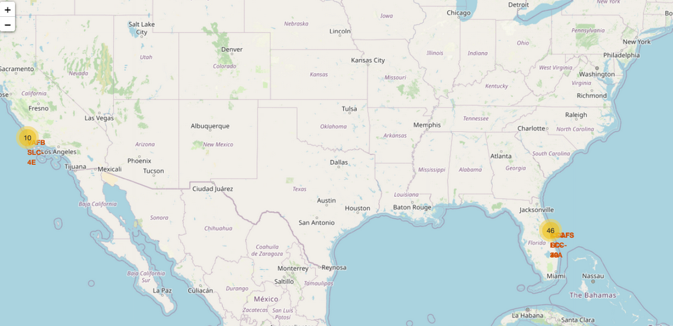
Build an Interactive Map with Folium
The objective is to have an interactive map that shows each launch site, adding a circle marker and label for the launch site. By using folium we can visualize the successful and failure launch sites by colors.
We create objects for :
Make a mark on the map by creating map marker
Create icons on the map by creating icon marker
Show markers that have been selected by creating circle with circle marker
Draw lines between points by using polyline
Create clusters to group different objects that tend to be located close each other by using maker cluster object
Draw different line points or arrows between line points by using ant path
This would help us to understand if launch sites are close each other, if there is good access to the launch sites, and detect if there is a cluster where the successful launch rate is high and how many launches are located in that site.

Slide 14
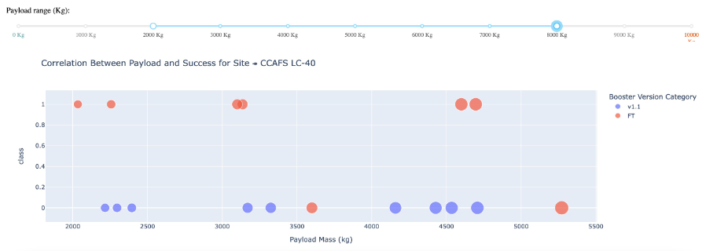
Build a Dashboard with Plotly Dash
The objective is to have an interactive dashboard with two different plots, a pie chart and a scatter plot. The former will show the percentage of success in relation with the launch sites while the later the relationship between the success rate and the booster version category.
We Create objects for :
High level components for sliders, graphs, dropdowns, tables by creating dash and its components
Fetch values from dataset in the CVS format and create a data frame
Plot graphs interactively using Plotly
Launch sites by using dropdown
Payload Mass range selection in a range slider form
Pie charts and Scatter plots
This would help us to understand and interact with the data by using visualization tools, and would lead us to start to guess which launch site has more success rate and its possible influence for the predictive model.

Slide 15
Predictive Analysis (Classification)
Functions from the Scikit-learn library are used to create our machine learning models. The steps to build and train the models include :
Building the model
Load dataset into a Pandas data frame
Transform and standardize the data
Split data into training and test
Select the type of machine learning algorithm which include (Logistic regression, Support vector machine (SVM), Decision tree, K nearest neighbors (KNN))
Fit the models on the training data set
Find the best combination of hyperparameters for each model
Evaluating Model
Check accuracy for each model
Plot Confusion Matrix

Slide 16
Results
Exploratory data analysis results
Interactive analytics demo in screenshots
Predictive analysis results

Slide 17

Section 2

Slide 18
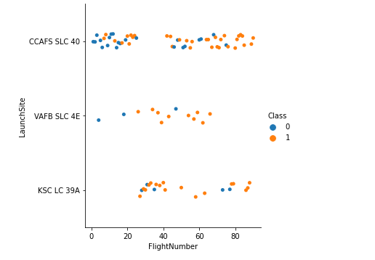
Flight Number vs. Launch Site
Launches from the site of CCAFS SLC 40 are significantly higher than the other launch sites.

Slide 19
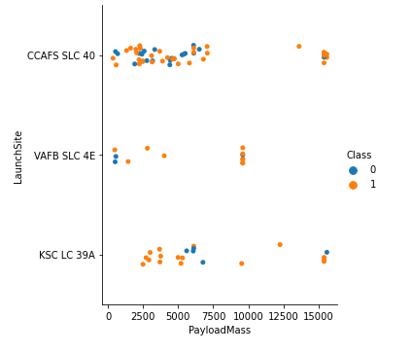
Payload vs. Launch Site
VAFB-SLC launch site has no rockets launched with a heavy payload mass(greater than 10000).
The majority of rockets launched with a payload less than 10000 have been launched from the CCAFS SLC 40 launch site.

Slide 20
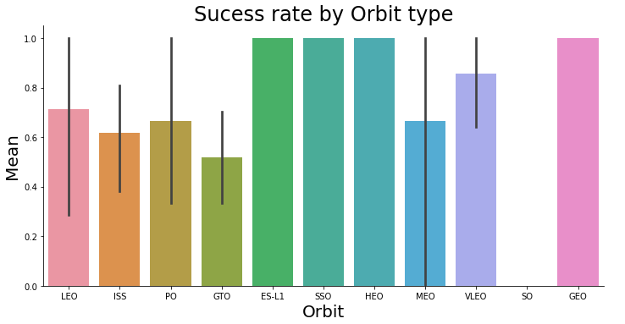
Success Rate vs. Orbit Type
ES-L1, GEO, HEO and SSO have a success rate of 100%.
SO has a success rate of 0%.

Slide 21
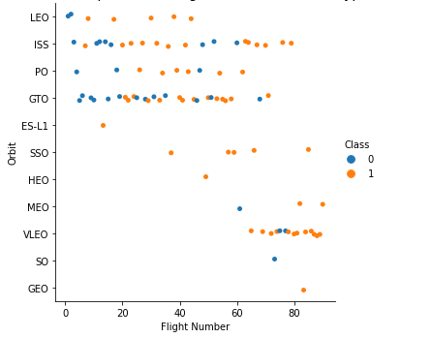
Flight Number vs. Orbit Type
A trend can be observed of shifting to VLEO launches in recent years.

Slide 22
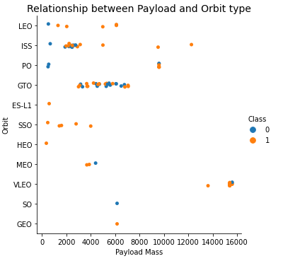
Payload vs. Orbit Type
We can see the concentration of ~2500 payload mass at the ISS orbit, and payloads between 4000-7000 at the GTO orbit.

Slide 23
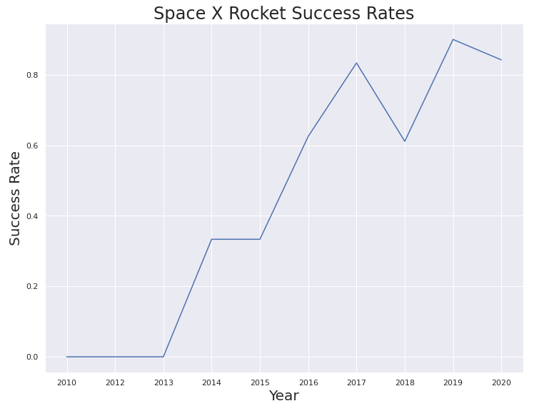
Launch Success Yearly Trend
Since 2013 there has been a meteoric rise in the success rate.

Slide 24
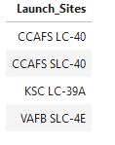
All Launch Site Names
The names of the unique launch sites in the space mission

Slide 25
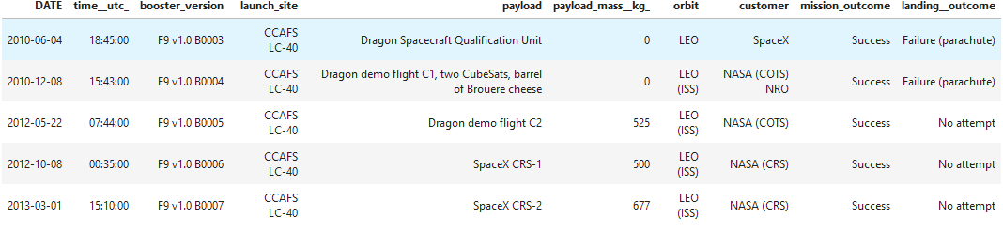
Launch Site Names Begin with 'CCA'
5 records where launch sites begin with ‘CCA’

Slide 26
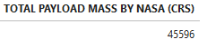
Total Payload Mass
The total payload mass carried by boosters launched by NASA (CRS)

Slide 27
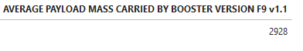
Average Payload Mass by F9 v1.1
The average payload mass carried by booster version F9 v1.1

Slide 28

First Successful Ground Landing Date
The date when the first successful landing outcome in ground pad was achieved

Slide 29
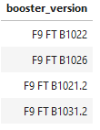
Successful Drone Ship Landing with Payload between 4000 and 6000
The names of the boosters which have success in drone ship and have payload mass greater than 4000 but less than 6000

Slide 30
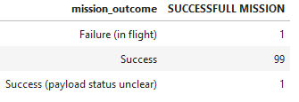
Total Number of Successful and Failure Mission Outcomes
The total number of successful and failure mission outcomes

Slide 31
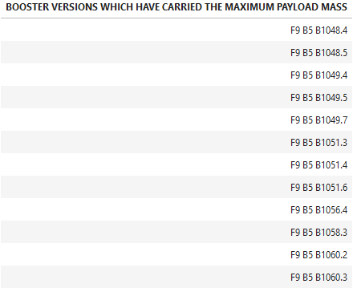
Boosters Carried Maximum Payload
The names of the booster versions which have carried the maximum payload mass

Slide 32
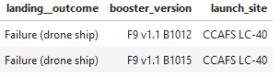
2015 Launch Records
The failed landing outcomes in drone ship, their booster versions, and launch site names for in year 2015

Slide 33
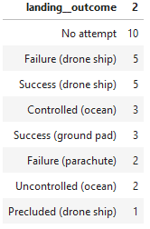
Rank Landing Outcomes Between 2010-06-04 and 2017-03-20
The count of landing outcomes between the date 2010-06-04 and 2017-03-20, in descending order

Slide 34

Section 3

Slide 35
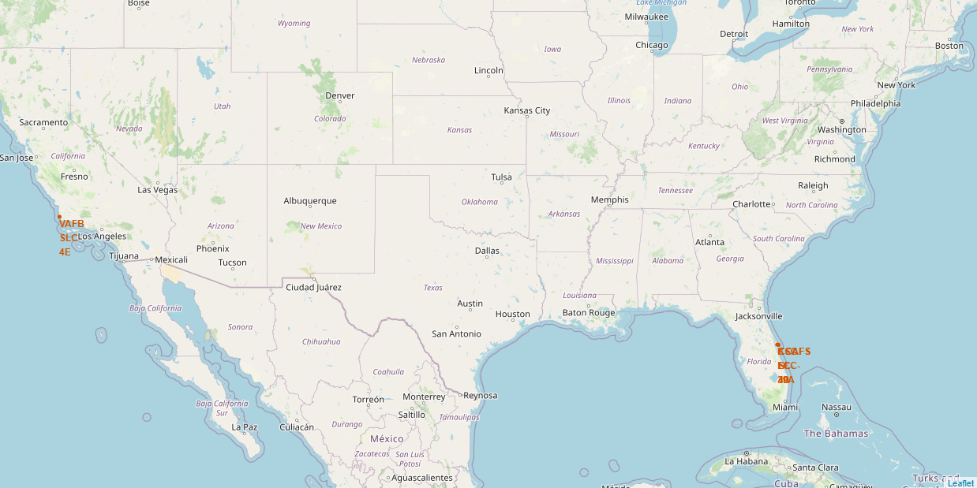
All launch sites on the map

Slide 36
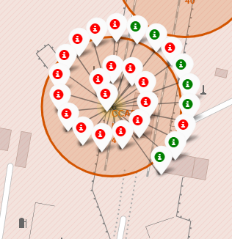
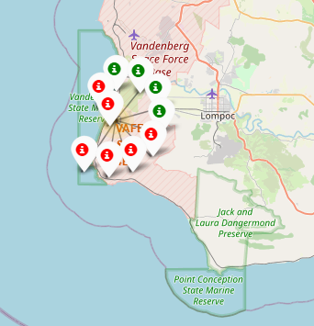
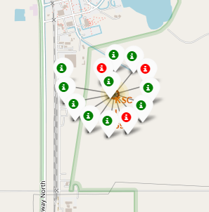
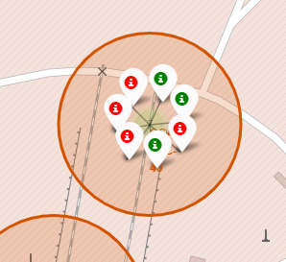
Success/Failed launches by site
Launches, decoded by their outcome, across launch sites, in the following order:
CCAFS LC - 40
VAFB SLC – 4E
KSC LC – 39A
CCAFS SLC - 40

Slide 37
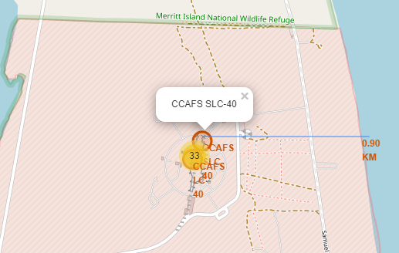
Distance between launch sites to its proximities
The picture shows the distance between the CCAFS SLC-40 launch site and the nearest coastline.

Slide 38

Section 4

Slide 39
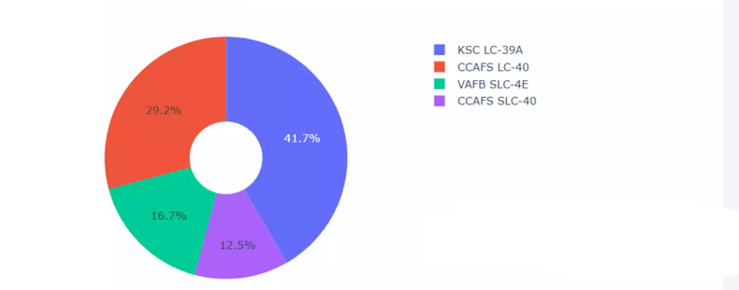
Launch Success Count
KSC LC-39A has the highest success score with 41.70%.
CCAFS LC-40 comes next with 29.20%.
Finally, VAFB SLC-4E and CCAFS SLC-40 with 16.70% and 12.50% respectively.

Slide 40
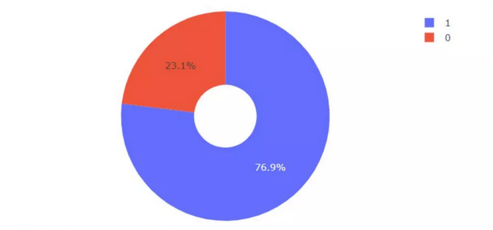
Success rate by launch site
LSC LC-39A has the highest score with 76.9% with payload range of 2000kg – 10000kg, and FT booster version has the highest score.

Slide 41
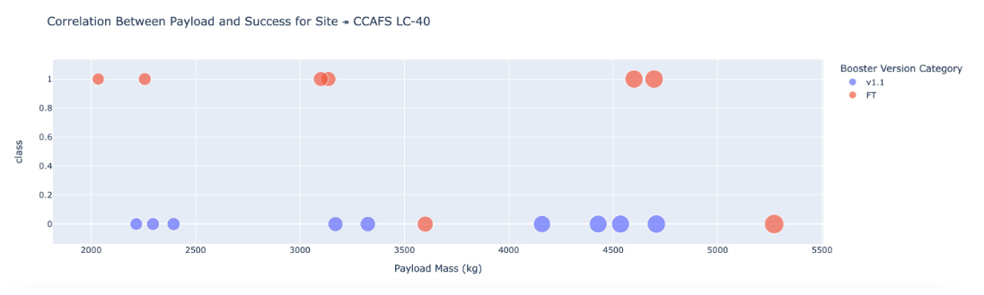
Payload vs. Launch Outcome
We can see the success rates for low weighted payloads is higher than the heavy weighted payloads.

Slide 42

Section 5

Slide 43
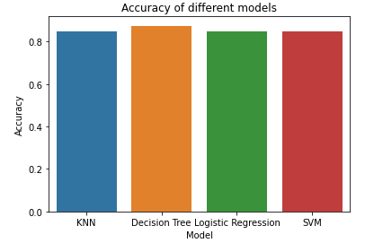
Classification Accuracy

Slide 44
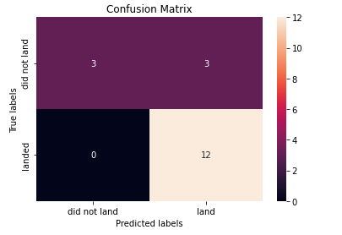
Confusion Matrix
Put side by side all the models have the same accuracy and confusion matrix on the test data.
Therefore, we use their GirdSearchCV scores to rank them. Based on that Decision Tree Classifier has the best accuracy off the 4 models. The accuracies are : Logistic Regression - 0.846429 SVM - 0.848214 KNN - 0.848214 Decision Tree - 0.875000

Slide 45
Conclusions
In this project, we try to predict if the first stage of a given Falcon 9 launch will land in order to determine the cost of a launch.
Each feature of a Falcon 9 launch, such as its payload mass or orbit type, may affect the mission outcome in a certain way.
Several machine learning algorithms are employed to learn the patterns of past Falcon 9 launch data to produce predictive models that can be used to predict the outcome of a Falcon 9 launch.
The predictive model produced by decision tree algorithm performed the best among the 4 machine learning algorithms employed, with an accuracy of 87.5%.
Launch site KSC LC 39A, and orbits GEO, HEO, SSO, ES L1 have the highest success rates.

Slide 46


